Slide 1
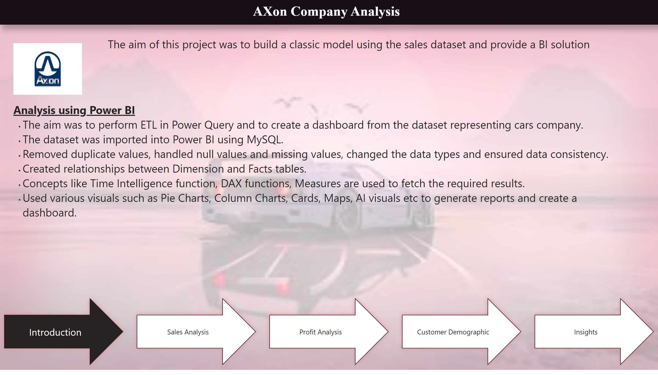
Introduction
Notes:
shape
No alt text provided
shape
No alt text provided
textbox
No alt text provided
textbox
No alt text provided
pageNavigator
No alt text provided
image
No alt text provided
textbox
No alt text provided

Slide 2
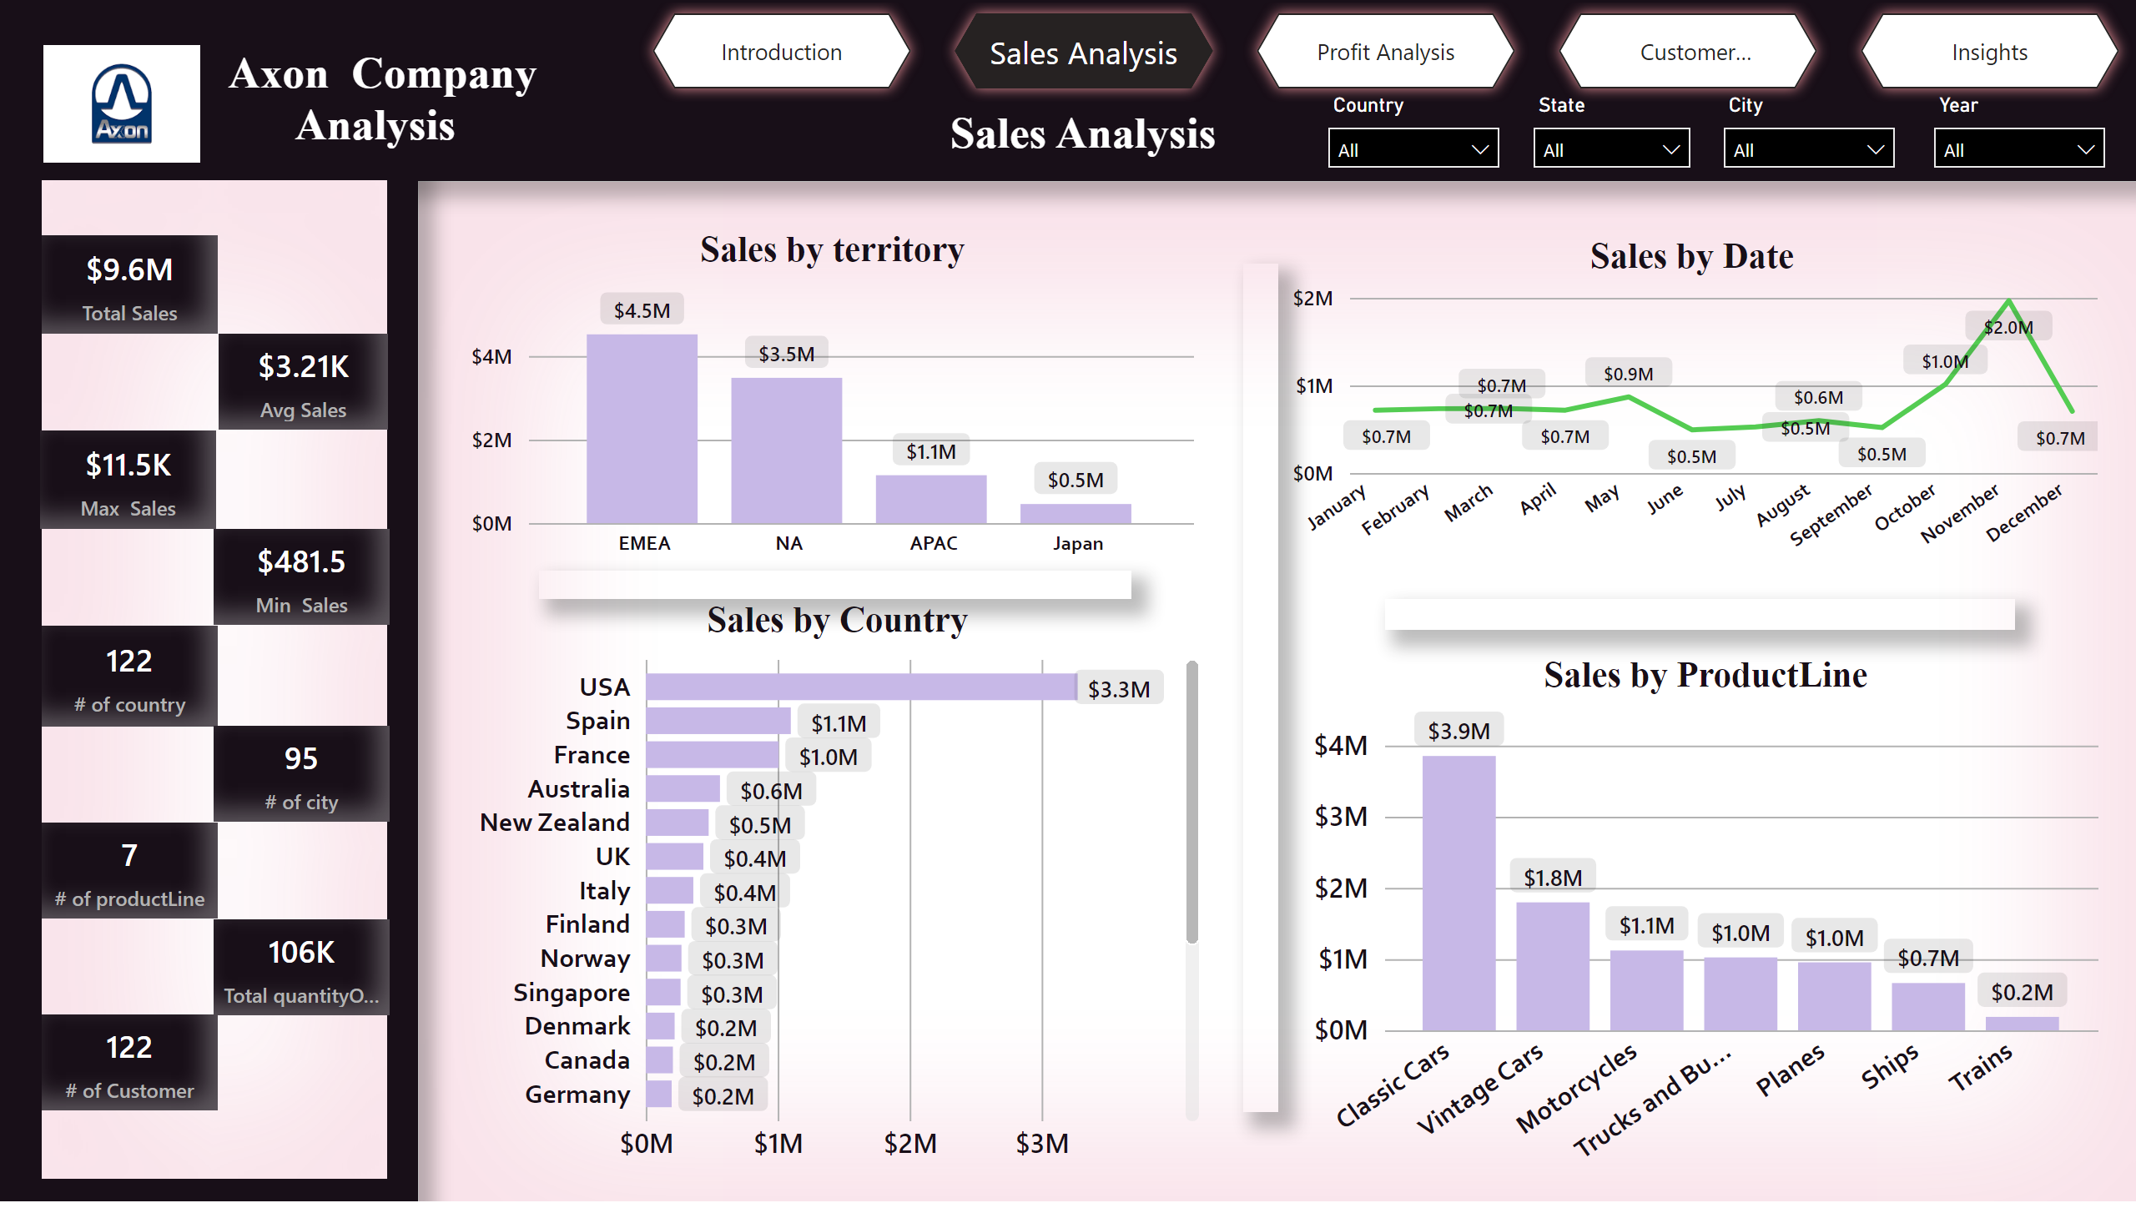
Sales Analysis
Notes:
shape
No alt text provided
shape
No alt text provided
shape
No alt text provided
shape
No alt text provided
Sales by territory
No alt text provided
Sales by Date
No alt text provided
Sales by Country
No alt text provided
Sales by ProductLine
No alt text provided
slicer
No alt text provided
slicer
No alt text provided
slicer
No alt text provided
slicer
No alt text provided
textbox
No alt text provided
shape
No alt text provided
shape
No alt text provided
shape
No alt text provided
shape
No alt text provided
Total sales
No alt text provided
Total sales
No alt text provided
Total sales
No alt text provided
Total sales
No alt text provided
Total sales
No alt text provided
Total sales
No alt text provided
image
No alt text provided
pageNavigator
No alt text provided
textbox
No alt text provided
Total sales
No alt text provided
Total sales
No alt text provided
Total sales
No alt text provided

Slide 3
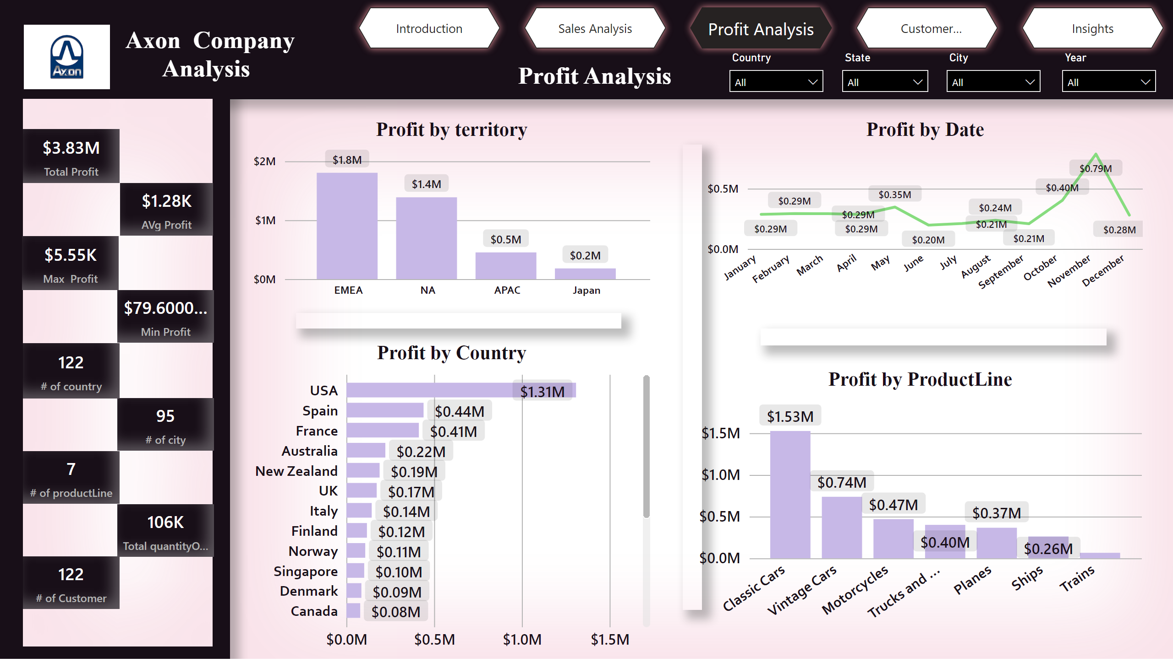
Profit Analysis
Notes:
shape
No alt text provided
shape
No alt text provided
shape
No alt text provided
shape
No alt text provided
Profit by territory
No alt text provided
Profit by Date
No alt text provided
Profit by Country
No alt text provided
Profit by ProductLine
No alt text provided
shape
No alt text provided
shape
No alt text provided
shape
No alt text provided
slicer
No alt text provided
slicer
No alt text provided
slicer
No alt text provided
slicer
No alt text provided
pageNavigator
No alt text provided
shape
No alt text provided
Total sales
No alt text provided
Total sales
No alt text provided
Total sales
No alt text provided
Total sales
No alt text provided
Total sales
No alt text provided
Total sales
No alt text provided
Total sales
No alt text provided
Total sales
No alt text provided
Total sales
No alt text provided
image
No alt text provided
textbox
No alt text provided
textbox
No alt text provided

Slide 4
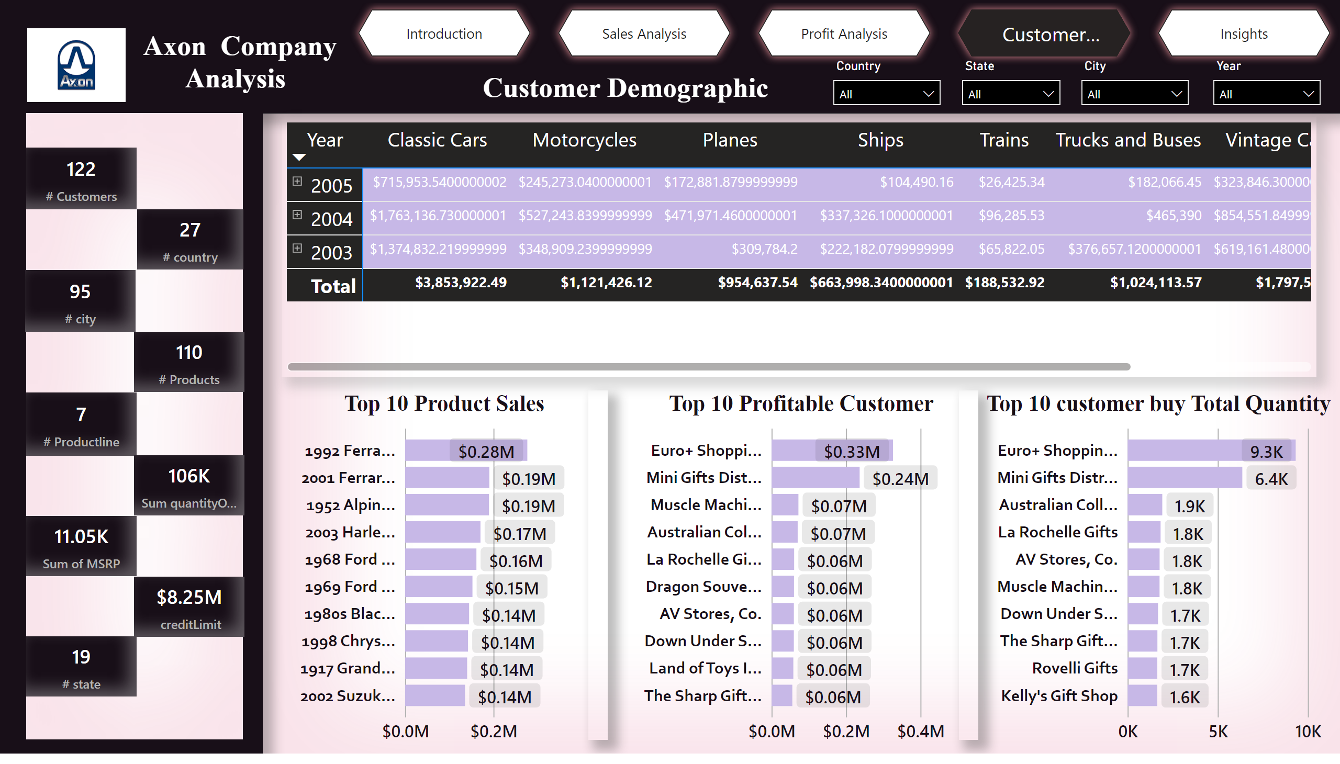
Customer Demographic
Notes:
shape
No alt text provided
shape
No alt text provided
shape
No alt text provided
shape
No alt text provided
Top 10 Product Sales
No alt text provided
Top 10 Profitable Customer
No alt text provided
Top 10 customer buy Total Quantity
No alt text provided
Sales by territory
No alt text provided
shape
No alt text provided
shape
No alt text provided
slicer
No alt text provided
slicer
No alt text provided
slicer
No alt text provided
slicer
No alt text provided
pageNavigator
No alt text provided
shape
No alt text provided
Total sales
No alt text provided
Total sales
No alt text provided
Total sales
No alt text provided
Total sales
No alt text provided
Total sales
No alt text provided
Total sales
No alt text provided
Total sales
No alt text provided
Total sales
No alt text provided
Total sales
No alt text provided
image
No alt text provided
textbox
No alt text provided
textbox
No alt text provided

Slide 5
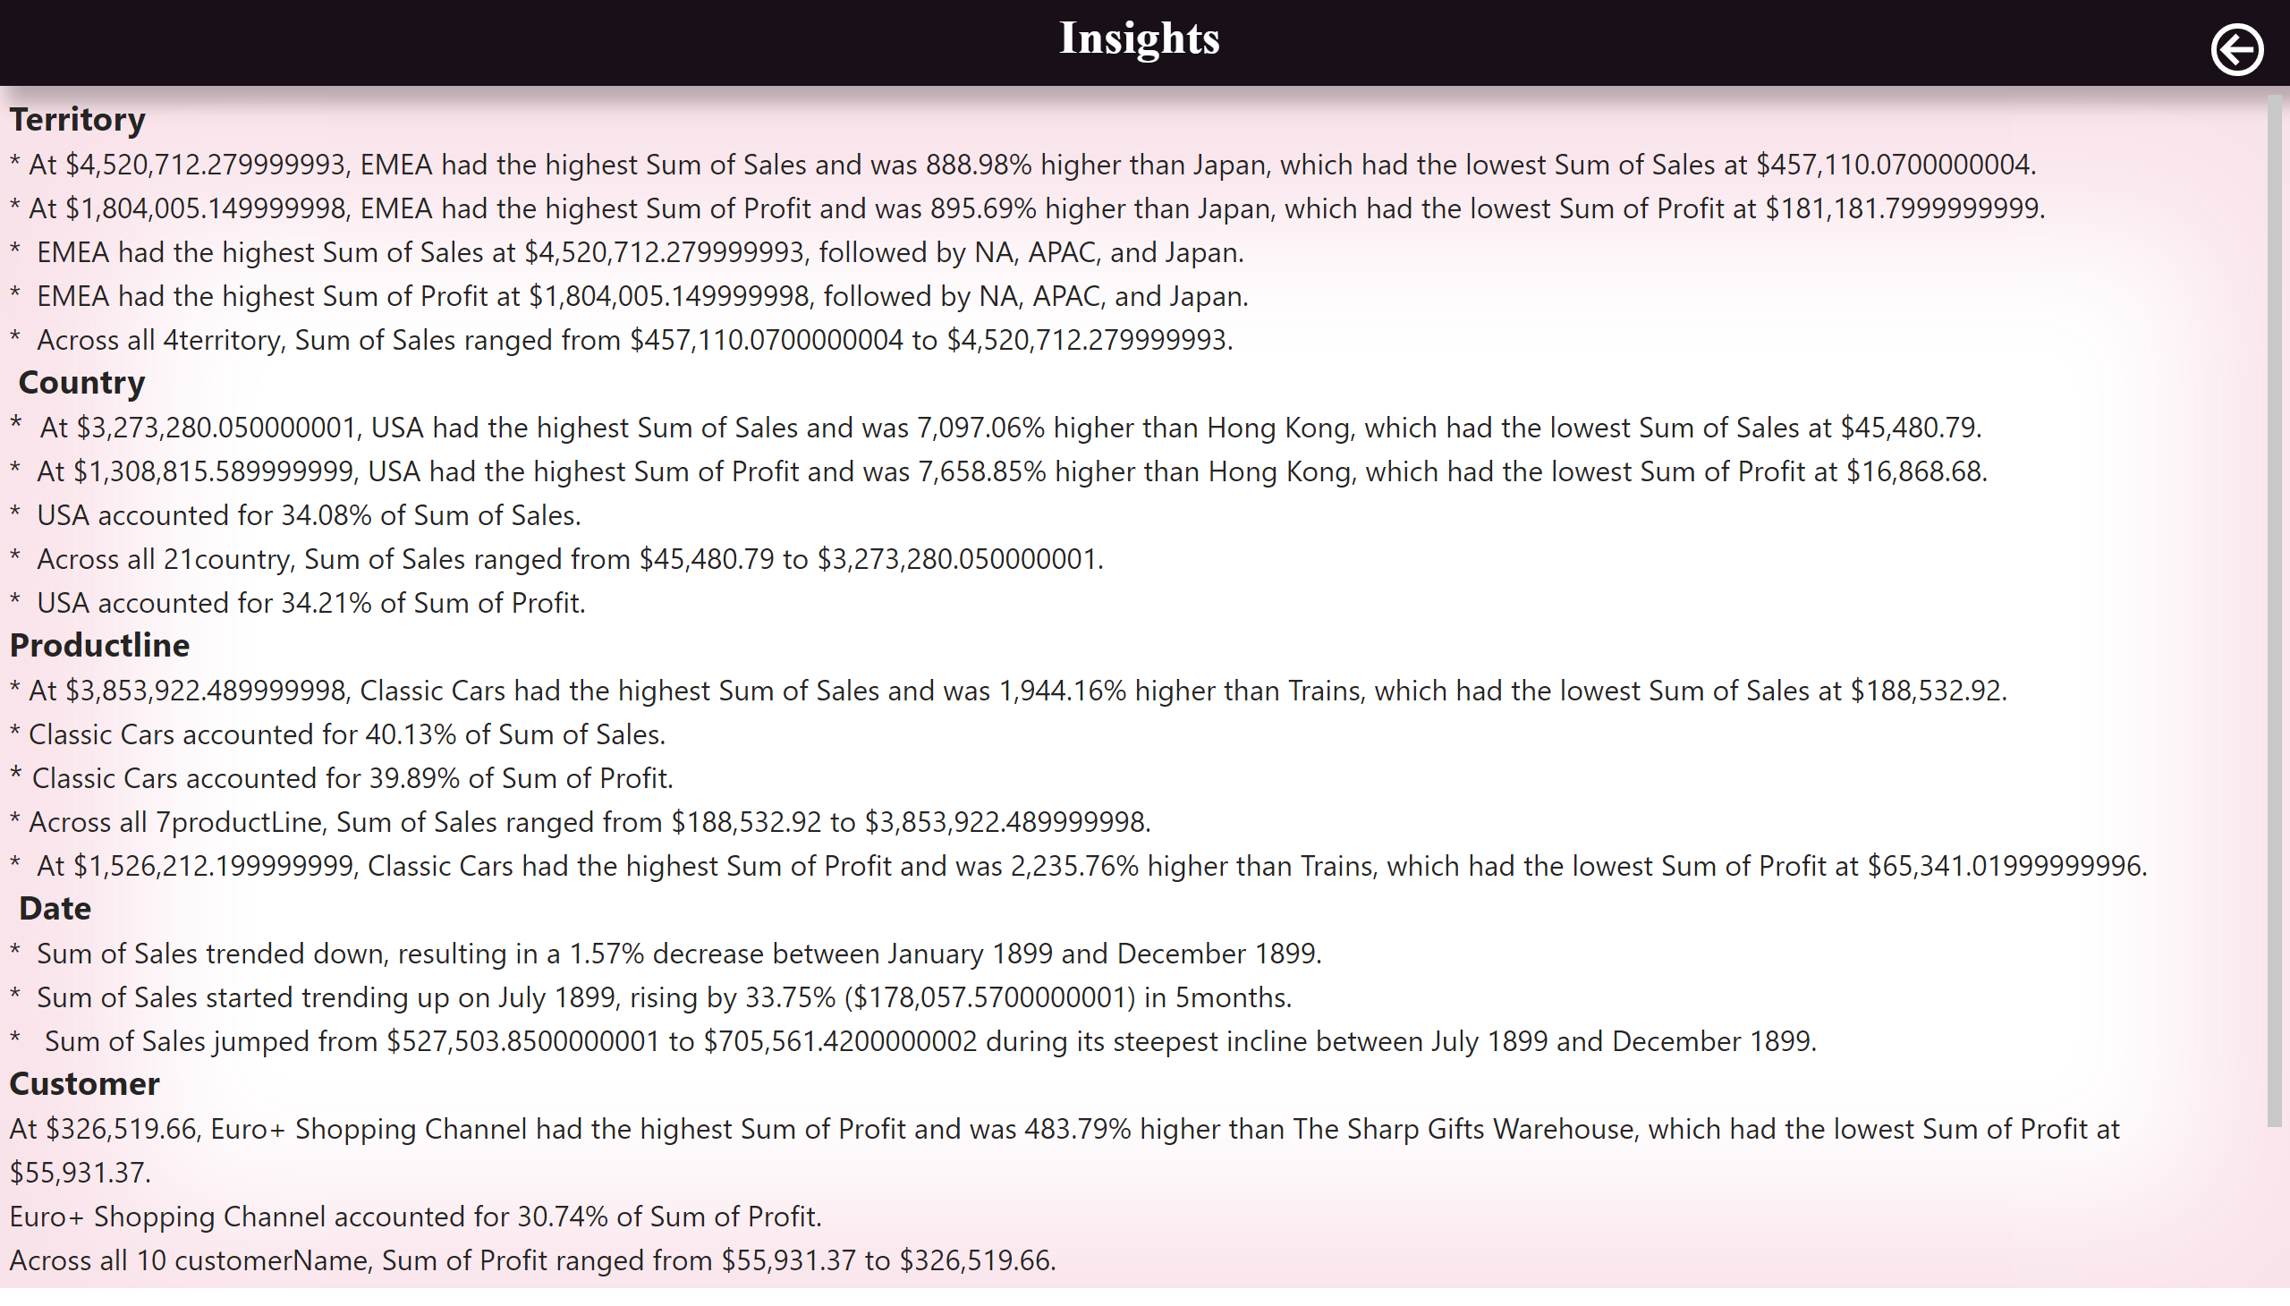
Insights
Notes:
shape
No alt text provided
shape
No alt text provided
textbox
No alt text provided
textbox
No alt text provided
actionButton
No alt text provided

